Slide 1
Lecture 3 Working with data in R II
Trevor A. Branch
FISH 552 Introduction to R

Slide 2
Recommended reading
An introduction to R (Venables et al.)
http://cran.r-project.org/doc/manuals/R-intro.pdf
Chapters 4, 5.1-5.4, 5.9, 6.1-6.2, 7

Slide 3
Matrices
Data frames: store objects of different types
Matrices: store objects all of the same type
> x <- matrix(data=1:6,
nrow=3, ncol=2,
byrow=FALSE)
> x
[,1] [,2]
[1,] 1 4
[2,] 2 5
[3,] 3 6
Numbers to put into matrix
Number of rows, number of columns
Fill numbers in by column
Number of elements provided should be nrow × ncol

Slide 4
Creating matrices
Matrix from the years visiting each island
> nislands <- length(islands)
> years <- seq(2013, length.out=nislands)
> isl.mat <- matrix(c(years, islands), ncol=2, nrow=nislands)
> head(isl.mat, n=2)
[,1] [,2]
[1,] 2013 11506
[2,] 2014 5500
Fast way to create matrix using column bind (cbind)
> isl.mat <- cbind(years, islands)
> head(isl.mat, n=2)
years islands
Africa 2013 11506
Antarctica 2014 5500

Slide 5
Matrix functions
Matrix formation by row binding
> isl.row.mat <- rbind(years, islands)
> head(isl.row.mat)
Africa Antarctica Asia Australia...
years 2013 2014 2015 2016...
islands 11506 5500 16988 2968...
Use t() to transpose (switch columns and rows)
> t(isl.row.mat)
years islands
Africa 2013 11506
Antarctica 2014 5500
...

Slide 6
Matrix dimensions
Use the same functions to extract dimensions that were used for data frames
> dim(isl.mat)
[1] 48 2
> dim(isl.row.mat)
[1] 2 48
> nrow(isl.mat)
[1] 48
> ncol(isl.mat)
[1] 2

Slide 7
Arrays
Matrices have 2 dimensions, arrays have N dimensions
> isl.array <- array(data=c(years, islands), dim=c(nislands,2))
> head(isl.array, n=3)
[,1] [,2]
[1,] 2013 11506
[2,] 2014 5500
[3,] 2015 16988
A matrix is a special case of an array, but a data frame is not
> is.array(isl.array)
[1] TRUE
> is.array(isl.mat)
[1] TRUE
Create an array of dimension nislands × 2

Slide 8
3-dimensional array
Keep adding dimensions to the dim argument
> array(1:24, dim=c(3,4,2))
, , 1
[,1] [,2] [,3] [,4]
[1,] 1 4 7 10
[2,] 2 5 8 11
[3,] 3 6 9 12
, , 2
[,1] [,2] [,3] [,4]
[1,] 13 16 19 22
[2,] 14 17 20 23
[3,] 15 18 21 24
2 of the third dimension
4 columns
3 rows

Slide 9
Lists
Most flexible data structure
Each element can be varying length and mode
> description <- "Year of visit, island area (thousand sq miles)"
> isl.list <- list(meta=description, nislands=nislands, data=isl.mat)
> isl.list
$meta
[1] "Year of visit, island area (thousand sq miles)"
$nislands
[1] 48
$data
years islands
Africa 2013 11506
Antarctica 2014 5500

Slide 10
Extracting elements from lists
The $ operator works for lists
> isl.list <- list(meta=description, nislands=nislands, data=isl.mat)
> isl.list$meta
[1] "Year of visit, island area (thousand sq miles)" > isl.list$nislands
[1] 48
> isl.list$data[1:3,]
years islands
Africa 2013 11506
Antarctica 2014 5500
Asia 2015 16988

Slide 11
Converting data frames to lists
> patients <- data.frame(
id = c(31, 62, 50, 99, 53, 75, 54, 58, 4, 74),
age = c(12, 18, 20, 17, 14, 8, 12, 24, 24, 21),
sex = c("M", "F", "F", "M", "F", "M", "M", "F", "F", "M") )
> pat.list <- as.list(patients)
> pat.list
$id
[1] 31 62 50 99 53 75 54 58 4 74
$age
[1] 12 18 20 17 14 8 12 24 24 21
$sex
[1] M F F M F M M F F M
Levels: F M
R coerced the variable sex into a categorical variable during the data.frame statement, which is only apparent now

Slide 12
Using the [[ ]] operator for lists
[[ ]] extracts elements of lists (or $ if list elements are named)
> pat.list[[1]]
[1] 31 62 50 99 53 75 54 58 4 74
> pat.list$id
[1] 31 62 50 99 53 75 54 58 4 74
> pat.list[[1]][1]
[1] 31
> pat.list$id[1]
[1] 31

Slide 13
Changing list elements
> pat.list$id <- matrix(pat.list$id, ncol=2)
> pat.list
$id
[,1] [,2]
[1,] 31 75
[2,] 62 54
[3,] 50 58
[4,] 99 4
[5,] 53 74
$age
[1] 12 18 20 17 14 8 12 24 24 21
$sex
[1] M F F M F M M F F M
Levels: F M
Accessing elements of a matrix inside a list
> pat.list[[1]][1,1]
[1] 31
> pat.list[[1]][1,]
[1] 31 75

Slide 14
Categorical variables in R
A factor in R is a vector with discrete values assigned to individual elements, for example:
Male, female
Democrat, Republican, Unaffiliated
Factors are used in basic data manipulation, plotting routines, and especially in statistical models
R automatically specifies categorical variables as factors when
Creating data frames
Reading in data from files
Behind the scenes in many other applications

Slide 15
The factor function
We can specify a categorical variable as a factor with the factor() command
> zone <- c("demersal", "pelagic", "reef", "demersal")
> is.factor(zone)
[1] FALSE
> zone.fac <- factor(zone)
> zone.fac
[1] demersal pelagic reef demersal
Levels: demersal pelagic reef
> is.factor(zone.fac)
[1] TRUE

Slide 16
Numbers to factors
Often a categorical variable is coded numerically in a database; then the labels argument can be used:
> zone <- c(1, 1, 1, 2, 2, 2, 1, 2, 2, 1)
> zone.fac <- factor(zone, labels=c("demersal", "pelagic"))
> zone.fac
[1] demersal demersal demersal pelagic pelagic pelagic demersal pelagic pelagic demersal
Levels: demersal pelagic
To find the levels of a factor:
> levels(zone.fac)
[1] "demersal" "pelagic"

Slide 17
Hands-on exercise 1
Create a 2×2 matrix Amat and a 2×3 matrix Bmat, each filled with unique numbers
Combine A and B into a 2×5 matrix Cmat and a 5×2 matrix Dmat
Create a factor Xfactor from the following vector such that 1 is female and 2 is male
sex <- c(1,1,2,1,2,2,2,1,1,1)
Create a list called data that contains matrices Amat, Bmat and Xfactor
Extract the first row of the matrix Amat from the list data
Change to NA the value in row 1 and column 1 of matrix Bmat within data.

Slide 18
Reading in data
There are three oft-used functions
scan()
Most primitive, most flexible since it reads into a vector, and very fast, use for large or very messy data
read.table()
Easiest to use, reads into a data frame
read.csv()
Most useful for reading in Excel worksheets or other comma-separated data

Slide 19
Manual entry of data
Nearly always data are read in from a text file like .csv, but data can be entered manually from the keyboard
> co2 <- scan()
1: 316
2: 316.91
3: 317.63
4: 318.46
5:
Read 4 items
> co2
[1] 316.00 316.91 317.63 318.46

Slide 20
Reading in data from a file
read.table() has a number of common options (useful defaults listed below)
header=T first row has names for columns
sep=" " how are entries separated (white space)
na.strings=NA which values are treated as NAs
skip=0 the number of lines to skip before reading in data
nrows=-1 number of lines of data to read (-1 means all)
col.names=c("a","b") names for columns
Download data files in varying formats from Canvas website under "files/data files"

Slide 21
Good format data file
Download file "dat_df1.dat" from "files/data files"
Copy this to your current directory or a subdirectory called "\Data"
read.table(file="Data\\dat_df1.dat", header=T)
read.table(file="Data/dat_df1.dat", header=T)
read.table(file="C:\\Data\\dat_df1.dat", header=T)
read.table("http:/courses.washington.edu/fish552/data/dat_df1.dat", header=TRUE)
Need double backslash for directories
Or a single forward slash
Use the full directory path
You can download data from a website, but better to save the data on your computer

Slide 22
No column names
Read in "data_df2.dat" which is missing column names
> read.table(file="Data/dat_df2.dat")
V1 V2 V3
1 31 12 M
2 62 18 F
...
> read.table(file="Data/dat_df2.dat",
col.names=c("id","age","sex"))
id age sex
1 31 12 M
2 62 18 F
...

Slide 23
Comments preceding data are ignored
Read in "data_df3.dat" which has comments in the data file before the data
# Comments can precede the data
# Fake patient data
id age sex
31 12 M
...
> read.table(file="Data/dat_df3.dat", header=T)
id age sex
1 31 12 M
2 62 18 F
...

Slide 24
Omit part of data file
File "dat_df4.dat" has comments not preceded by #
> read.table(file="Data/dat_df4.dat", header=T)
Error in scan(file, what, nmax, sep, dec, quote, skip, nlines, na.strings, :
line 1 did not have 8 elements
> read.table(file="Data/dat_df4.dat", header=T, skip=3)
id age sex
1 31 12 M
2 62 18 F
...

Slide 25
Data not separated by white space
Read in "dat_df5.dat"
> read.table(file="Data/dat_df5.dat", sep="/", header=T)
id age sex
1 31 12 M
2 62 18 F
...
Read in .csv file with commas
> read.table(file="Data/dat_df1.csv", sep=",", header=T)

Slide 26
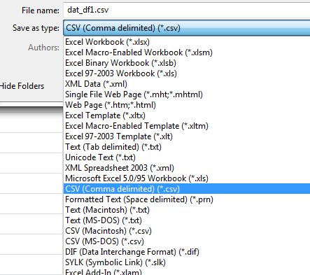
Data from Excel
Open fresh Excel workbook, single sheet, paste your data as values only, save as "Comma delimited (*.csv)"
Read the data in using read.csv()
> read.csv(file="Data/dat_df1.csv", header=T)
id age sex
1 31 12 M
2 62 18 F
3 50 20 F

Slide 27
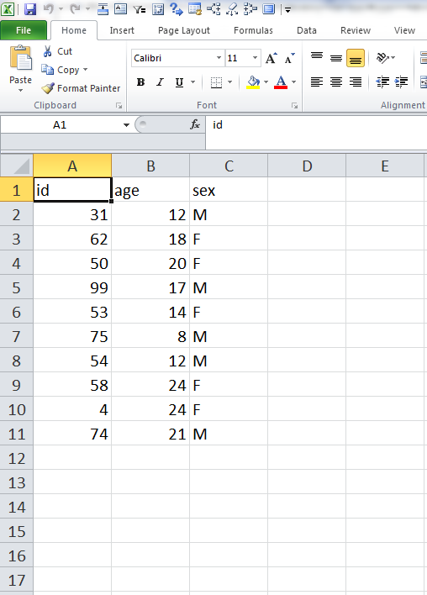
Excel sheet problems
All columns to the right and rows below should be empty and always have been empty hence the need for an empty sheet
Data should start in the top left corner
Or delete all rows below and all columns to the right in Excel before saving as .csv

Slide 28
Hands-on exercise 2
Read in the data contained in data file "data_df6.dat"
Examine the data first before reading it in
Missing values are indicated by -99 or -999 or NA
Convert all missing values into NA
The last column should be read in as a factor
Be sure to give the columns names (id, age, sex)
If you get stuck, go to the help file ?read.table

Slide 29
Reading in as text not factors
Most often I am using a database where I want the text to be text, and not factors
> x <- read.csv(file="Data/dat_df1.csv", header=T)
> x$sex
[1] M F F M F M M F F M
Levels: F M
> x <- read.csv(file="Data/dat_df1.csv", header=T,
+ stringsAsFactors=F)
> x$sex
[1] "M" "F" "F" "M" "F" "M" "M" "F" "F" "M"
stringsAsFactors controls how text is read in

